Slide 1
Market Analysis Project Presentation
Strategic Insights & Recommendations
2020 - 2022 Performance Review

Slide 2
Project Overview
This analysis evaluates market performance to identify growth drivers and optimization opportunities across key Latin American regions.
🌎
Geographic Scope
Focus on four key markets:
Brazil
Chile
Colombia
Mexico
📅
Analysis Period
Comprehensive review of sales and performance data spanning three years:
2020 – 2022
🔍
Key Questions
Strategic areas of inquiry:
Who is our customer mix?
What are the sales trends?
Which products drive value?

Slide 3
Problem Statement
The business generates large volumes of sales and customer data across multiple products, countries, and customer segments, but lacks a unified and interactive view to analyse performance effectively. Without clear visibility into customer demographics, regional sales patterns, product performance, and trends over time, decision-makers struggle to identify growth opportunities, optimize product strategy, and make timely data-driven decisions. This project aims to address this gap by transforming raw data into an intuitive Market Analysis Dashboard that delivers actionable insights.

Slide 4
Objectives
1
Provide a high-level overview of business performance using key KPIs
2
Analyse customer demographics by Age, Gender, Income group, Country
3
Identify top performing and under performing products.
4
Understand sales distribution across regions
5
Track sales trends over time (Yearly, Quarterly, Monthly)
6
Enable detailed product-level analysis using drill-through functionality

Slide 5





Data Preparation
Data Collection: Imported data from 2 csv files
Data Transformation: Merged the First Name and Last Name columns into a single Name field and removed duplicate records based on Customer ID
Created Date Table: Added Columns: Year, Quarter, Month, Month Number
Data Modelling: Establish relationships
1. Sales(Fact) -> Date(Dimension)
2. Sales(Fact) -> Customer(Dimension)
Prepared for Analysis:
Created Calculated Column: age group, income label
Measures: Total Sales, Total Orders, Average Monthly sales, Previous month sales, %YOY Change, % QOQ Change, %MOM Change

Slide 6
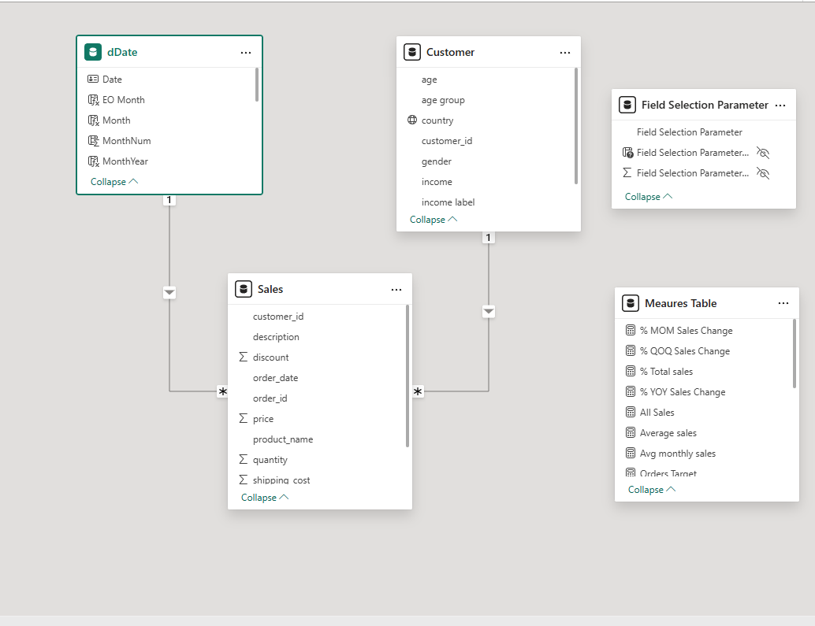
Entity Relationship Diagram

Slide 7
Methodology Overview
Our multi-faceted approach combines descriptive analytics with deep-dive segmentation.
📊
Descriptive Analytics
Interactive dashboards to visualize core metrics and KPIs.
📈
Trend Analysis
Time-series review to identify seasonal patterns and anomalies.
🎯
Segmentation
Drilling down by Region, Income Group, and Product .

Slide 8
Data Scope & Assumptions
Transaction Data
Core operational metrics including:
Order Volumes
Sales Revenue
Quantity Sold
Customer Demographics
Detailed profiles segmentation:
Age Groups
Gender Split
Income Segments
Analysis Parameters
Timeframe: January 2020 – December 2022 (Monthly/Quarterly granularity)
Geography: Brazil, Chile, Colombia, Mexico

Slide 9
Executive Summary
$311.27M
Total Sales
$8.65M
Avg Monthly Sales
244K
Total Quantity
1,000
Total Customers
44K
Total Orders
311.27M in total sales across 44K orders
1,000 customers contributing consistent monthly revenue
Strong performance from home and lifestyle product categories
Balanced customer demographics across age and gender
Medium-income customers contribute the largest share of revenue
Latin American markets drive the majority of sales

Slide 10
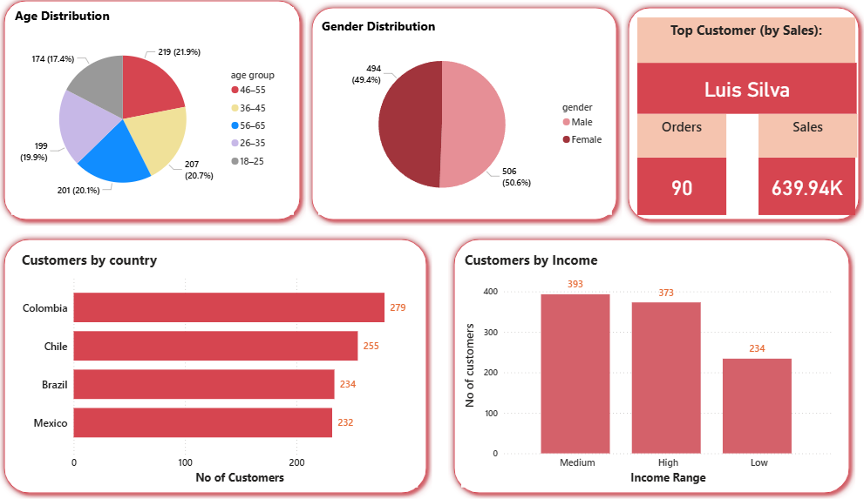
Customer Demographics Insights
Age & Gender
Customer distribution is fairly balanced across age groups, with no single group dominating.
The 26–45 age range contributes the largest share, indicating strong participation from working professionals.
Gender split is nearly 50–50, indicating broad market appeal
Country
Customer base is concentrated in Latin American markets.
Colombia leads slightly, but distribution is relatively balanced.
Income
Medium-income customers form the largest and most valuable segment
High-income customers also contribute significantly
Low-income segment has lower sales contribution

Slide 11
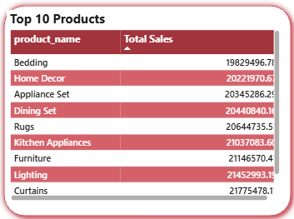
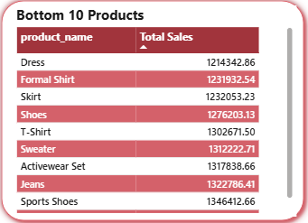
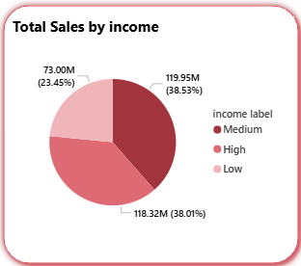
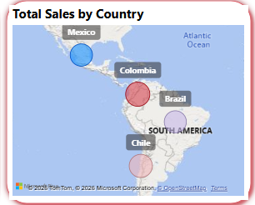
Sales Performance Highlights
Top 10 Products by Sales
Categories like Curtains, Lighting, Furniture, Kitchen Appliances, Bedding lead revenue.
Indicates strong performance in home and lifestyle products.
Bottom 10 Products by Sales
Items such as Dress, Formal Shirt, Skirt, Shoes show
lower sales contribution.
Geographical insight
Colombia and Chile generate higher sales volume
Brazil and Mexico show moderate but consistent contribution
Income
Medium income customers contribute the highest sales
High income follows closely
Low income contributes the least

Slide 12
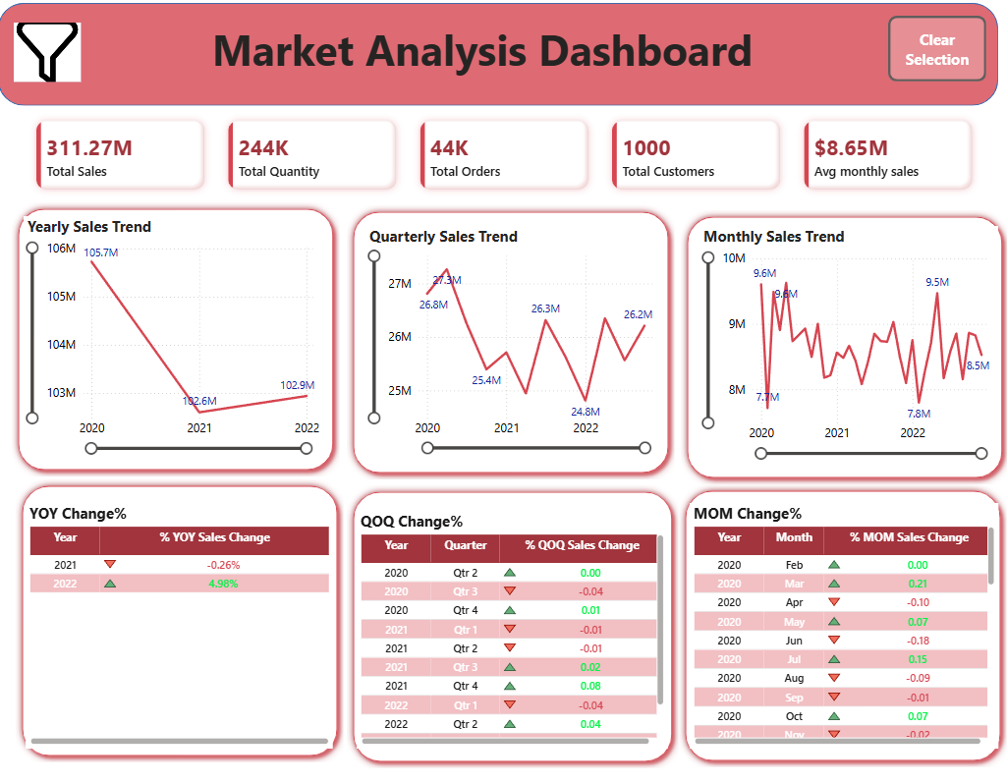
Time Series Trends
Yearly Trend & YoY Change
Sales declined slightly in 2021, followed by a strong
recovery in 2022.
The YoY change confirms this pattern:
2021: Negative YoY indicates a temporary slowdown
2022: Positive YoY shows renewed growth momentum
Quarterly Trend & QoQ Change
Quarterly sales fluctuate within a stable range, showing recurring ups and downs.
QoQ changes are mostly moderate, with no extreme spikes or drops.
Monthly Trend & MoM Change
Sales rise and fall across months, with repeating peak and dip periods.
MoM changes alternate between positive and negative values, reflecting normal operational fluctuations.

Slide 13
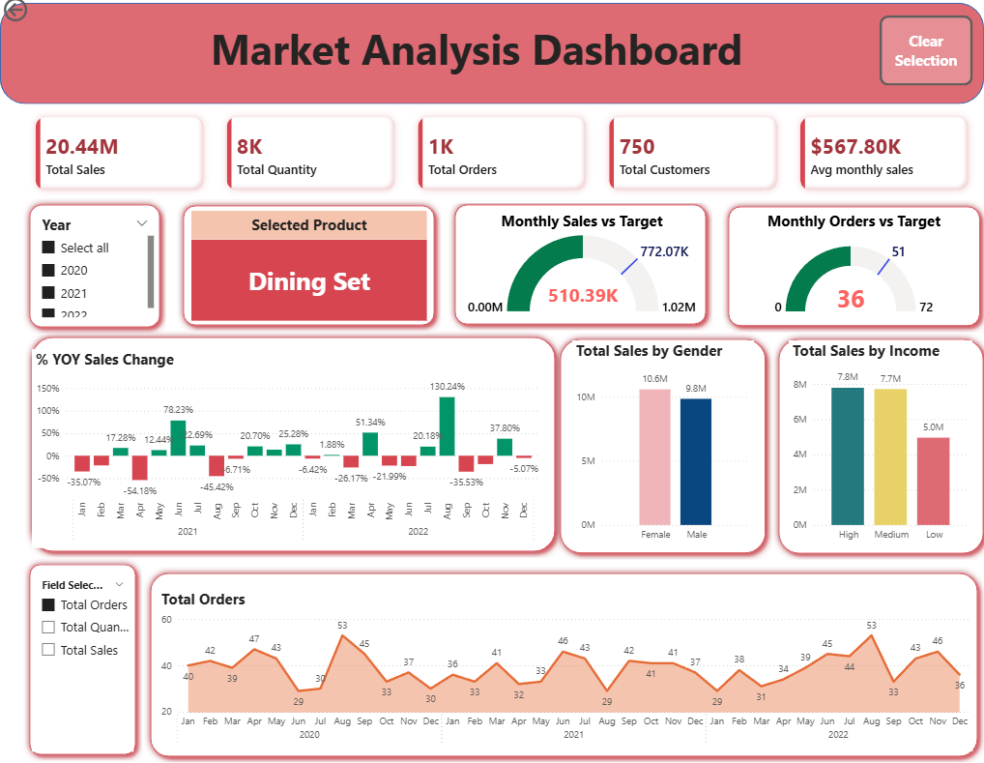
Product Detail-Drill-Through Analysis
SPOTLIGHT
Dining Set
This is a drill-through page that allows deep analysis of a selected product.
It enables decision-makers to move from summary-level insights to product-level details.
It supports:
Pricing decisions
Target setting
Product-specific promotions
Dining Set is a high-performing product with strong customer demand.

Slide 14
Conclusion
The business shows stable overall performance with consistent sales across products and regions.
Customer and regional analysis indicate diversified revenue with strong contribution from medium-income customers.
Time series trends reveal seasonal patterns with recovery after short-term dips, not long-term decline.
Product drill-through highlights performance gaps against targets, proving the value of detailed analysis.

Slide 15
Recommendations
Use seasonality insights to plan promotions, inventory, and targets.
Focus on high-performing product categories and optimize or review underperforming ones.
Increase order frequency for strong products through targeted offers or bundles.
Prioritize medium-income customer segments while sustaining high-value customers.

Slide 16

Thank You

